Slide 1


Web Innovation Edge
Jason Shoemaker Raj Singh Stephen Doyle
Customer Delivery Architect Software Architect Program Manager
Stardate 4.9.21

Slide 2
Collector-less Inventory and Device Configuration Collection
IE Demo Session
Megha Patil
24th Jan 2023

Slide 3
Agenda
Overview - Traditional Process, Business Challenge, Proposed Solution
What’s next
Q&A
Demo
What’s New
Cisco / IE Benefits

Slide 4
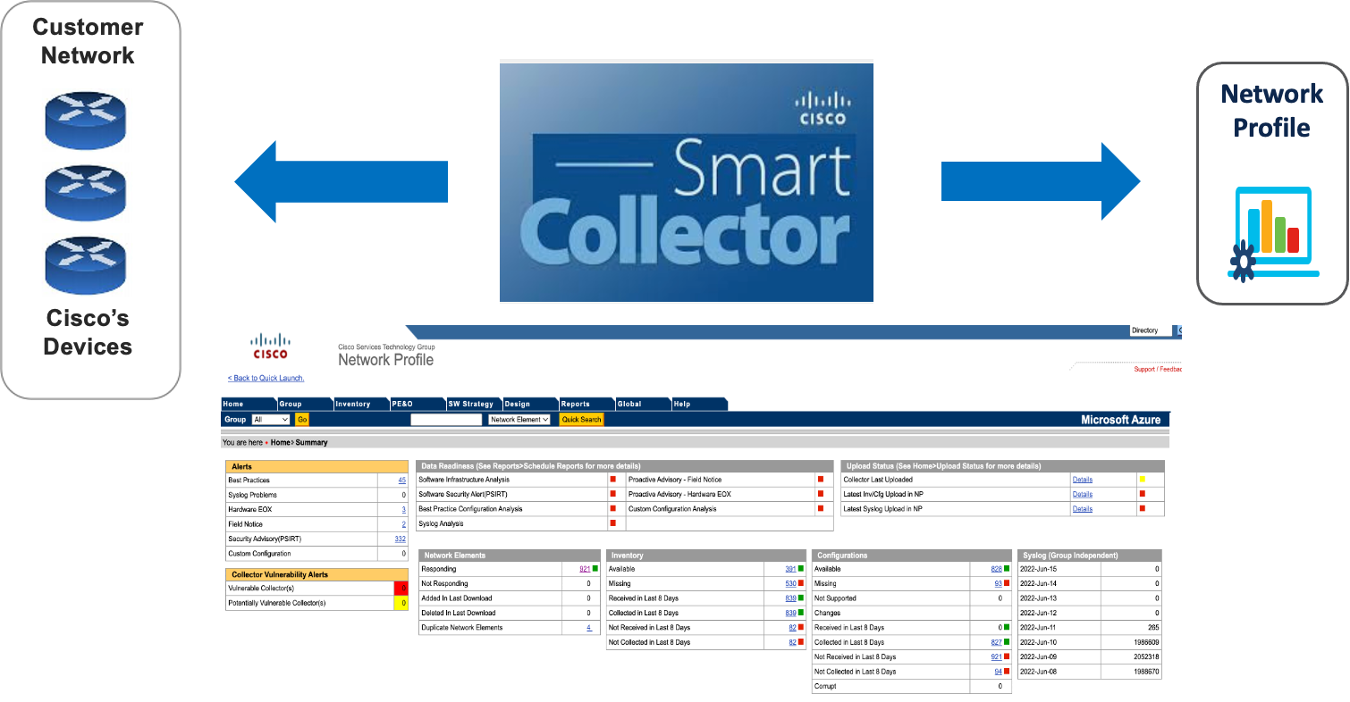
Traditional Process – Data collection

Slide 5
Business Challenges
1
CSPC upgrade
2
Customer’s approval to install CSPC software
3
Customer network devices security
4
Low network coverage
5
Unavailability of Device Inventory information
6
Network Anomalies detection failure due to missing data

Slide 6
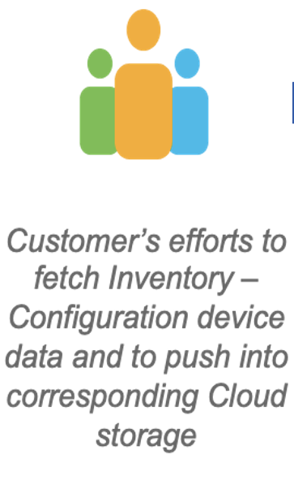
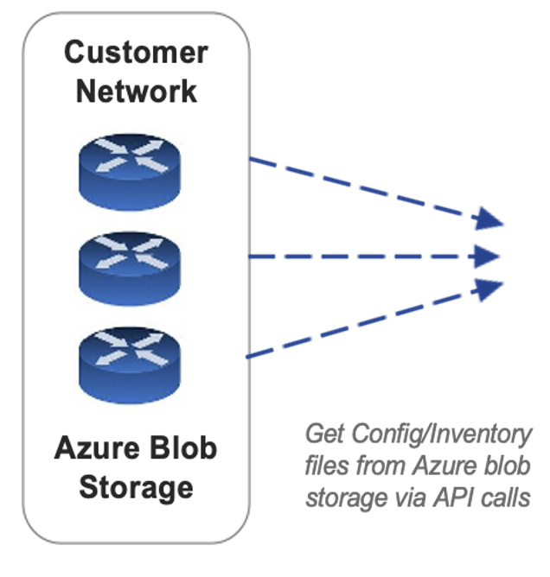
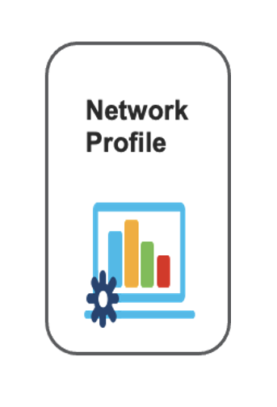
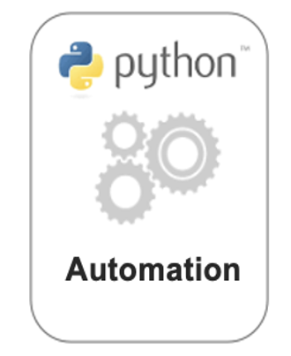

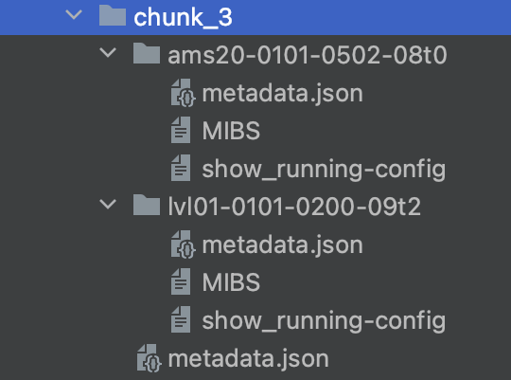
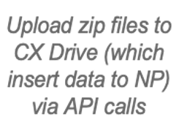
What’s New
Python Script to collect data files through API calls and convert it into a structure compatible for CXD Upload
Inventory.csv
Chunk 1 – CSPCID1
Chunk 2 – CSPCID2
Config.csv
Chunk 3– CSPCID3
OIC SDK
SNMP.log

Slide 7
Demo
Tech Stack: Python, Rest API's, GitHub

Slide 8
Cisco / IE Benefits
1
Large network coverage
2
Reduces CSPC maintenance overhead
3
Simplified management of data upload using API’s
4
Useful for BCS engineer
5
Re-usable solution for other web customers
6
Reduces hardware reliability issues

Slide 9
What’s Next
Considering devices information from TAC cases.
Code Shift POC
Evaluate use case for other customers like META, Apple
Airflow Integration

Slide 10
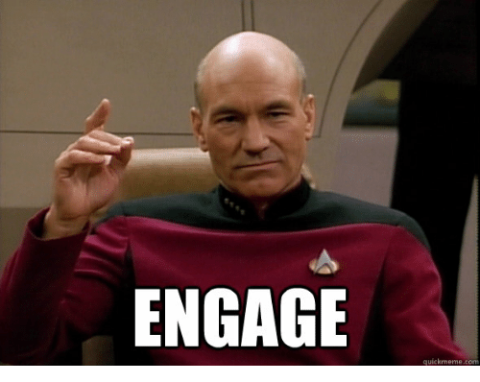
How To Engage the Team
For Potential New Projects:
Click here to submit your project details. Once you do, a Webex Space will be created.
An IE Team Lead will meet with you to discuss requirements and timelines
Priority will typically be given to projects tied to existing services engagements, well-qualified sales opportunities, or reusable solutions
For customer-facing discussions, trainings, and consultation, reach out to
cisco-ie-dev@cisco.com
Notes:
This team’s success is measured by the services revenue that it creates.

Slide 11



